Slide 1
Not User Friendly
Members: Brad Barker, Alex Gilbert, Jacob Ensor

Slide 2
Design
Mobile Platform
Android
Cloud Product
Google App Engine
Source Control
Github
Network
If phone is connected to Wifi it uses that
Defaults to 3G

Slide 3
Devices Supported
Android Smart Phones
Android Tablets

Slide 4
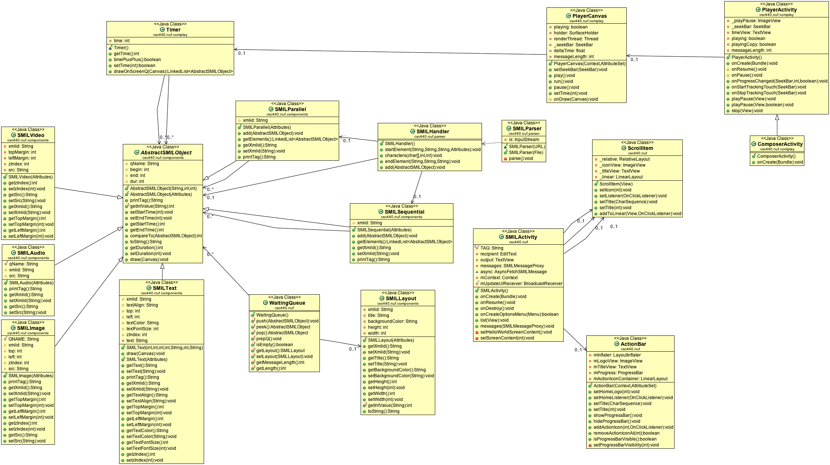
Client Uml Diagrams

Slide 5
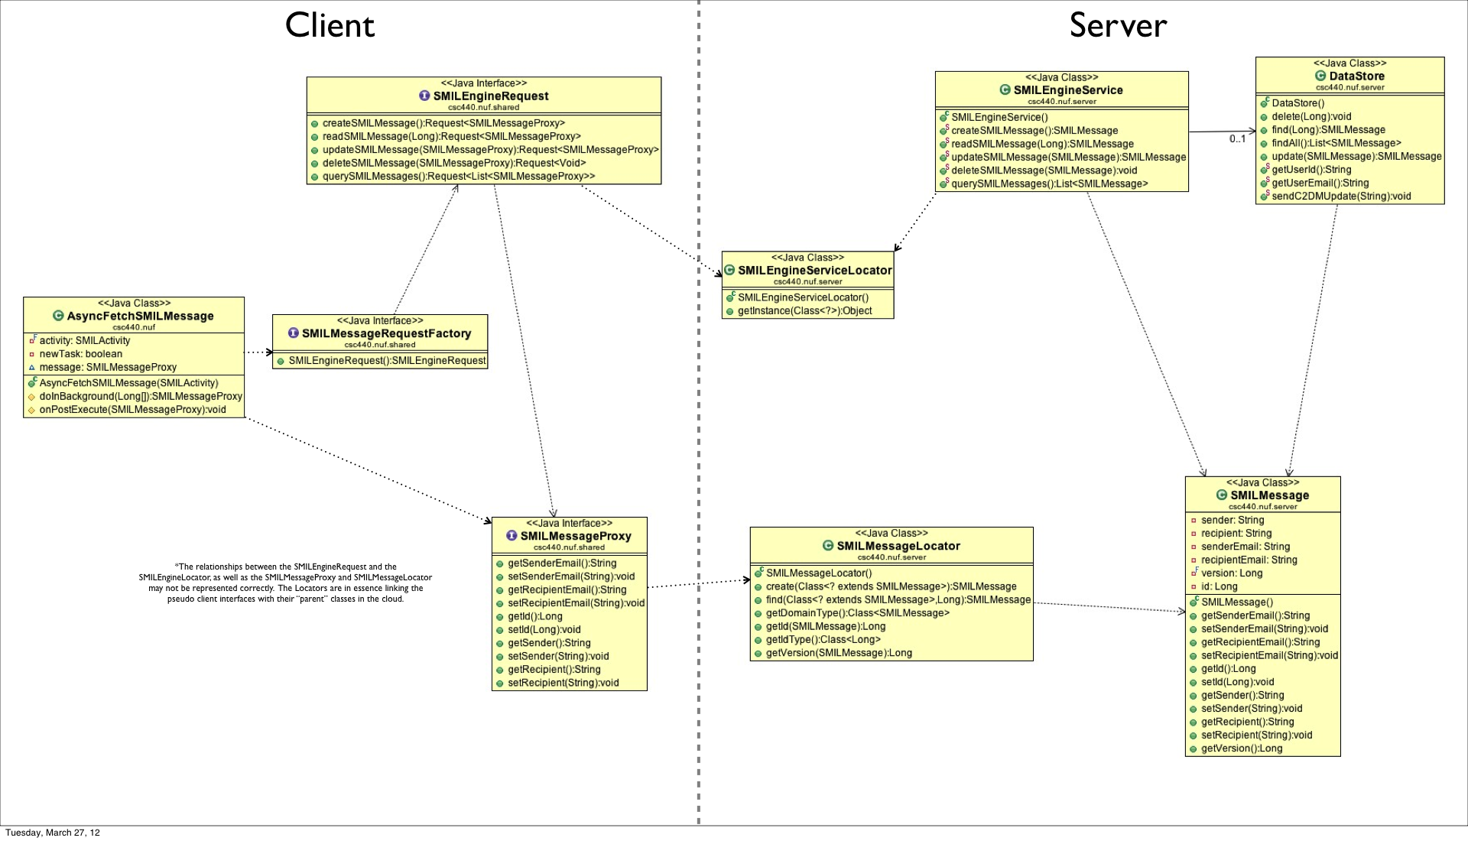
Server Uml Diagrams

Slide 6
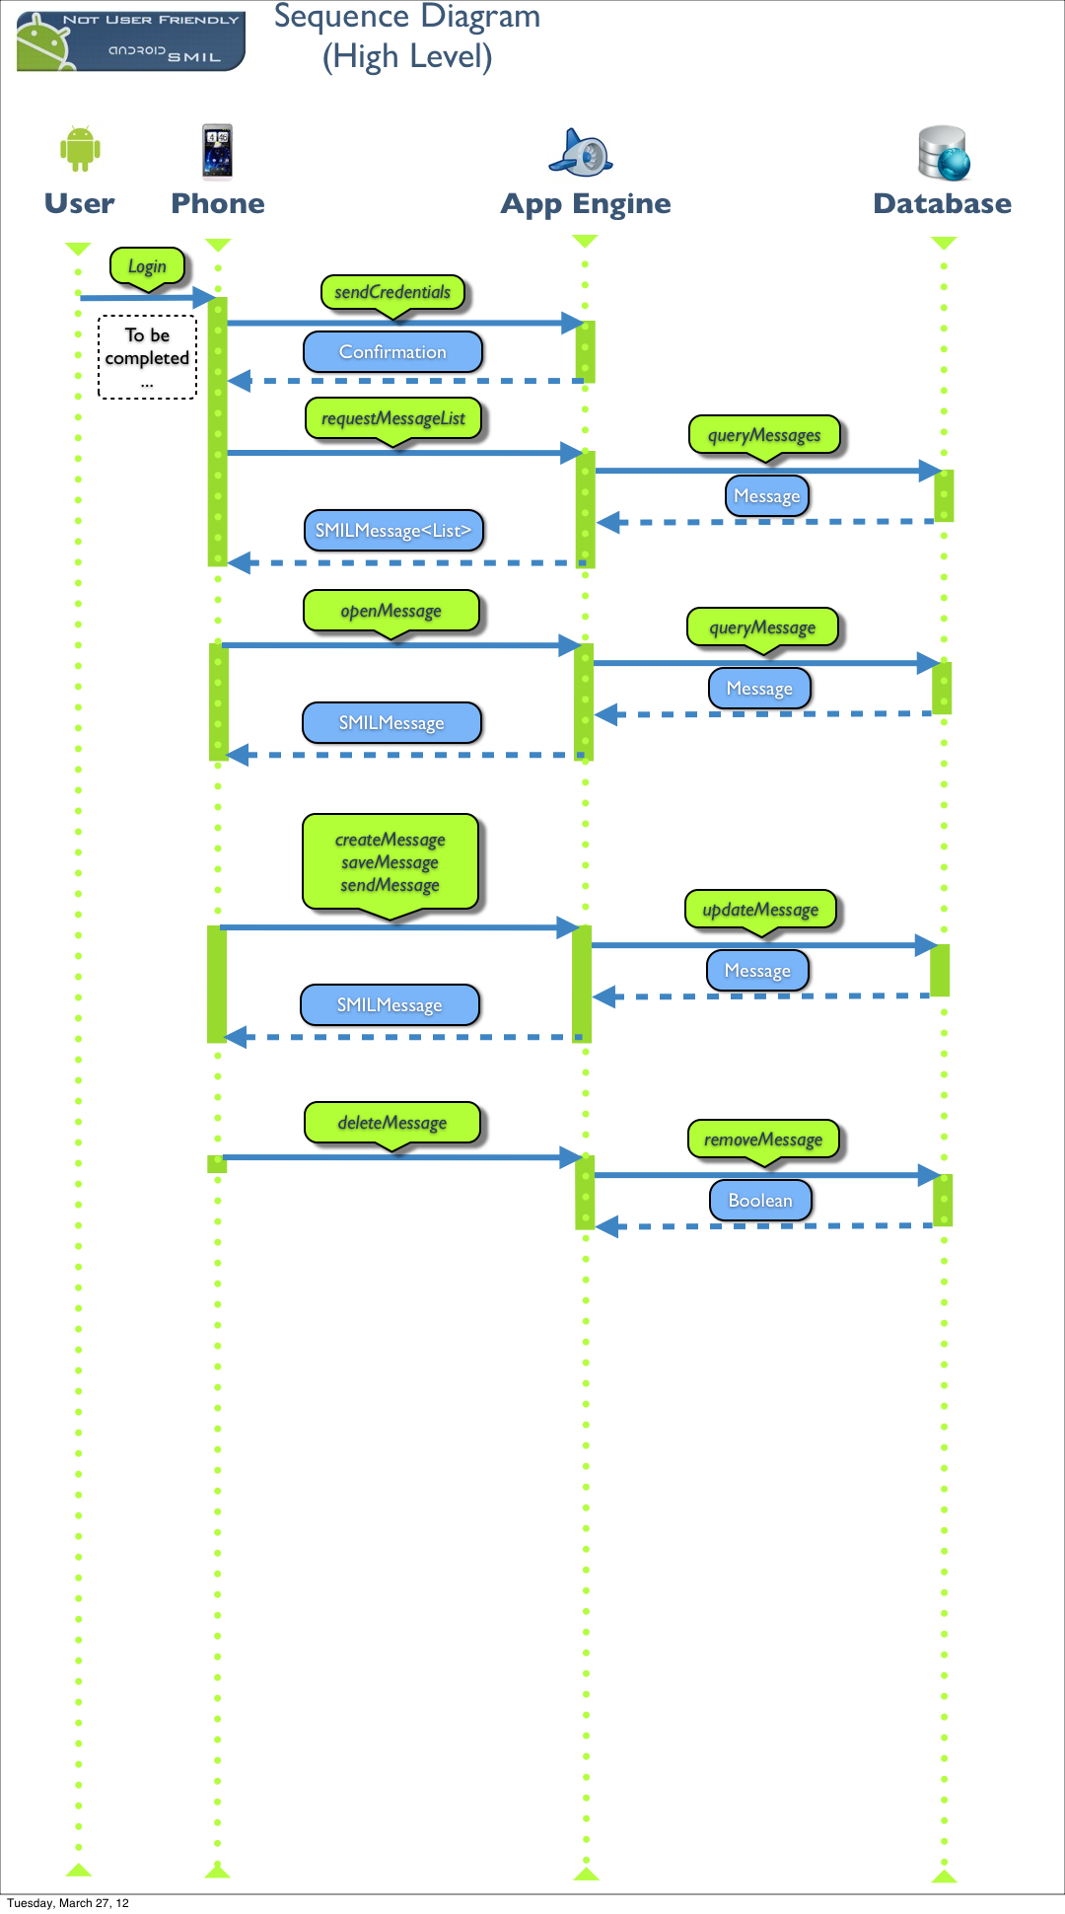
High Level Sequence Diagram

Slide 7
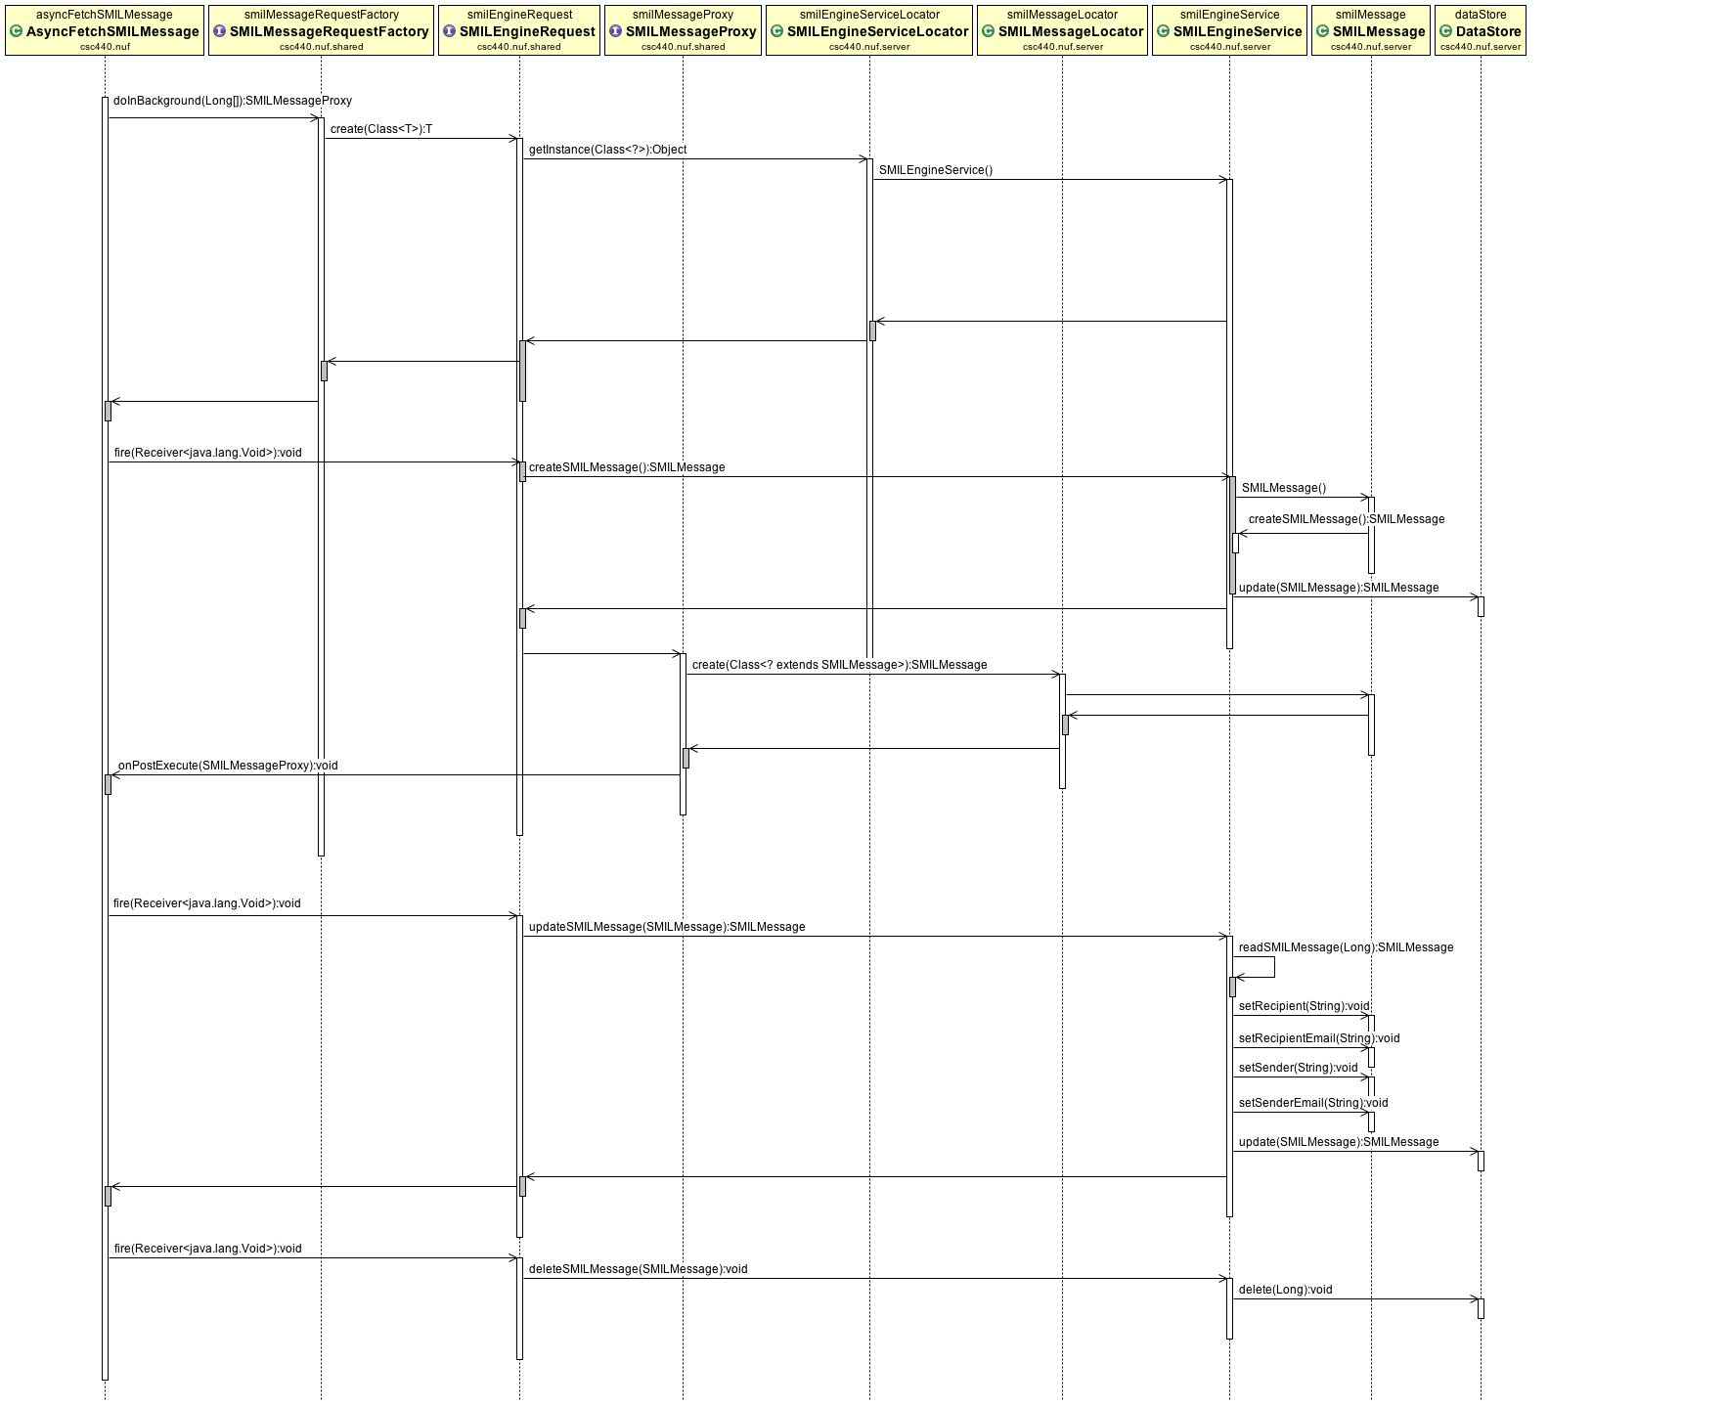
Cloud Sequence Diagram

Slide 8
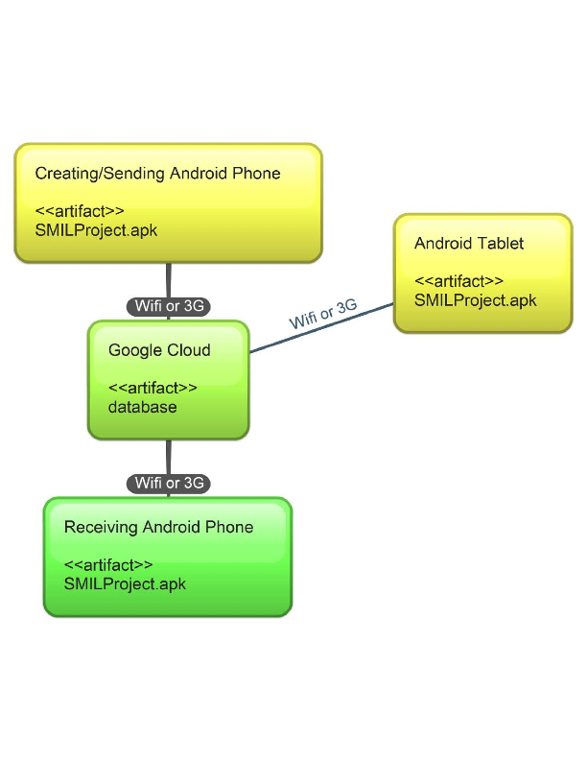
Deployment Diagram

Slide 9
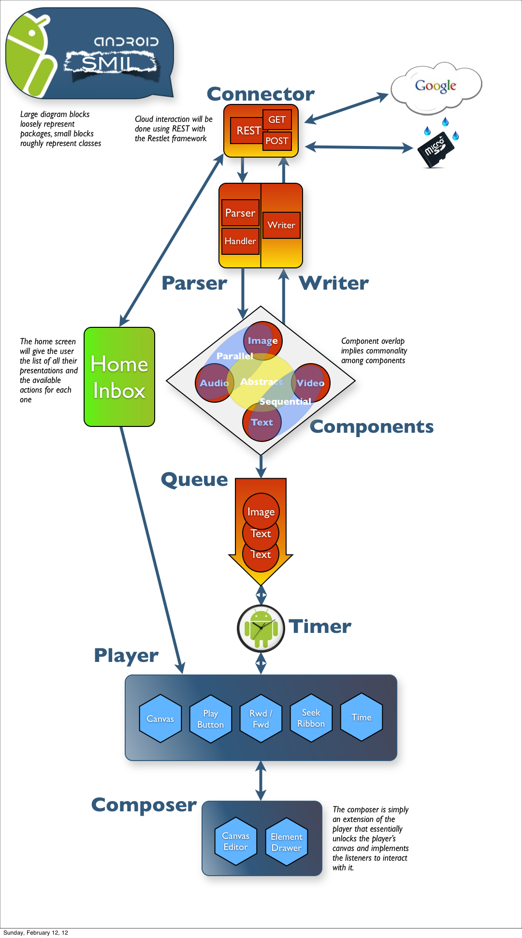
High Level Diagram

Slide 10
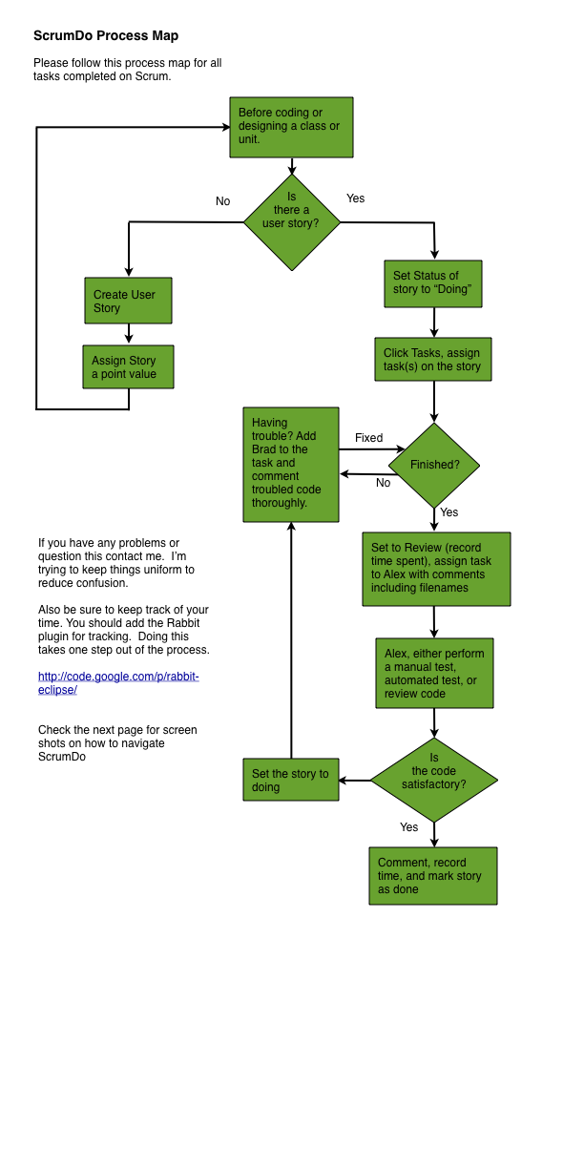
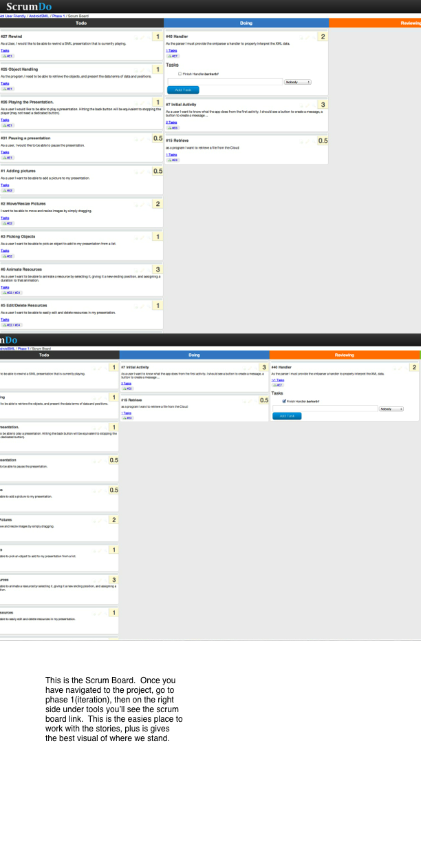
Task Process Map

Slide 11
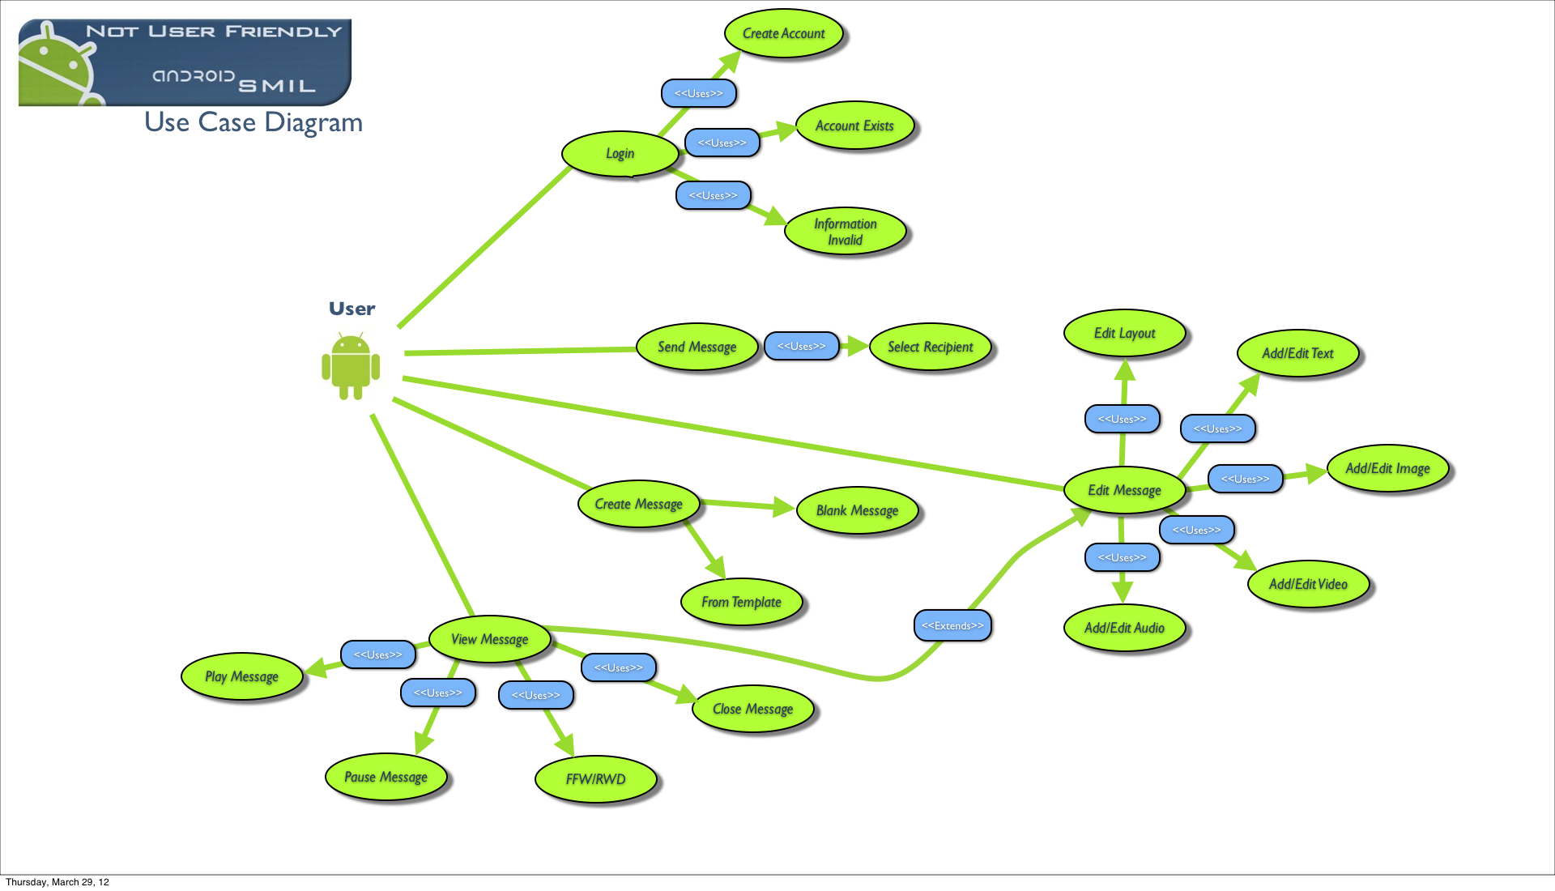

Slide 12
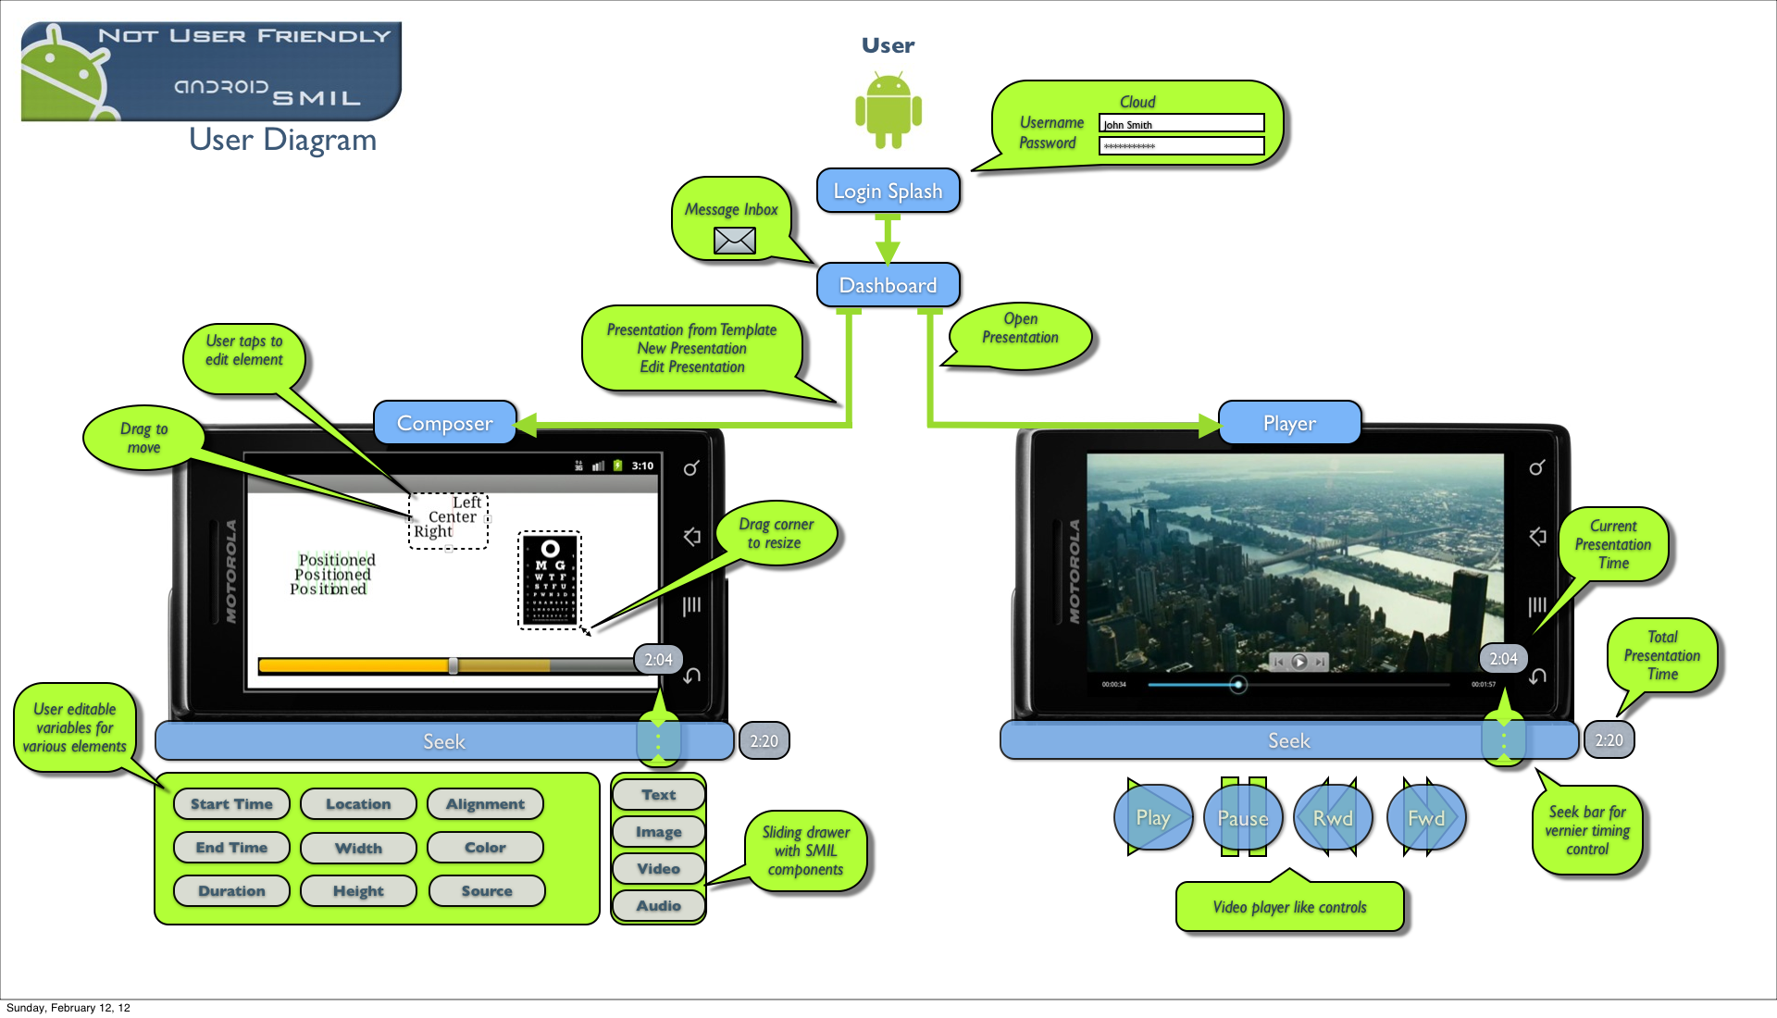

Slide 13
For the Next Class
Do not use Google App Engine!

Slide 14
What We Would Add

